Slide 1
Course
AWS Cloud Practitioner
MaxCloud

Slide 2
03
Class
Amazon RDS
Amazon Aurora
AWS DMS
AWS SCT

Slide 3
Amazon RDS
Amazon Relational Database Service (Amazon RDS) is a web service that makes it easier to set up, operate, and scale a relational database in the AWS Cloud.
It provides cost-efficient, resizable capacity for an industry-standard relational database and manages common database administration tasks.

Slide 4
Amazon RDS DB Engines
A DB engine is the specific relational database software that runs on your DB instance. Amazon RDS currently supports the following engines:
Db2
MariaDB
Microsoft SQL Server
MySQL
Oracle
PostgreSQL

Slide 5
Amazon RDS DB instance classes
A DB instance class determines the computation and memory capacity of a DB instance.
A DB instance class consists of both the DB instance type and the size.
Each instance type offers different compute, memory, and storage capabilities.
https://aws.amazon.com/rds/instance-types/

Slide 6
Amazon RDS DB instance store
Amazon EBS provides durable, block-level storage volumes that you can attach to a running instance. DB instance storage comes in the following types:
General Purpose (SSD)
Provisioned IOPS (PIOPS)
Magnetic
https://docs.aws.amazon.com/AmazonRDS/latest/UserGuide/CHAP_Storage.html

Slide 7
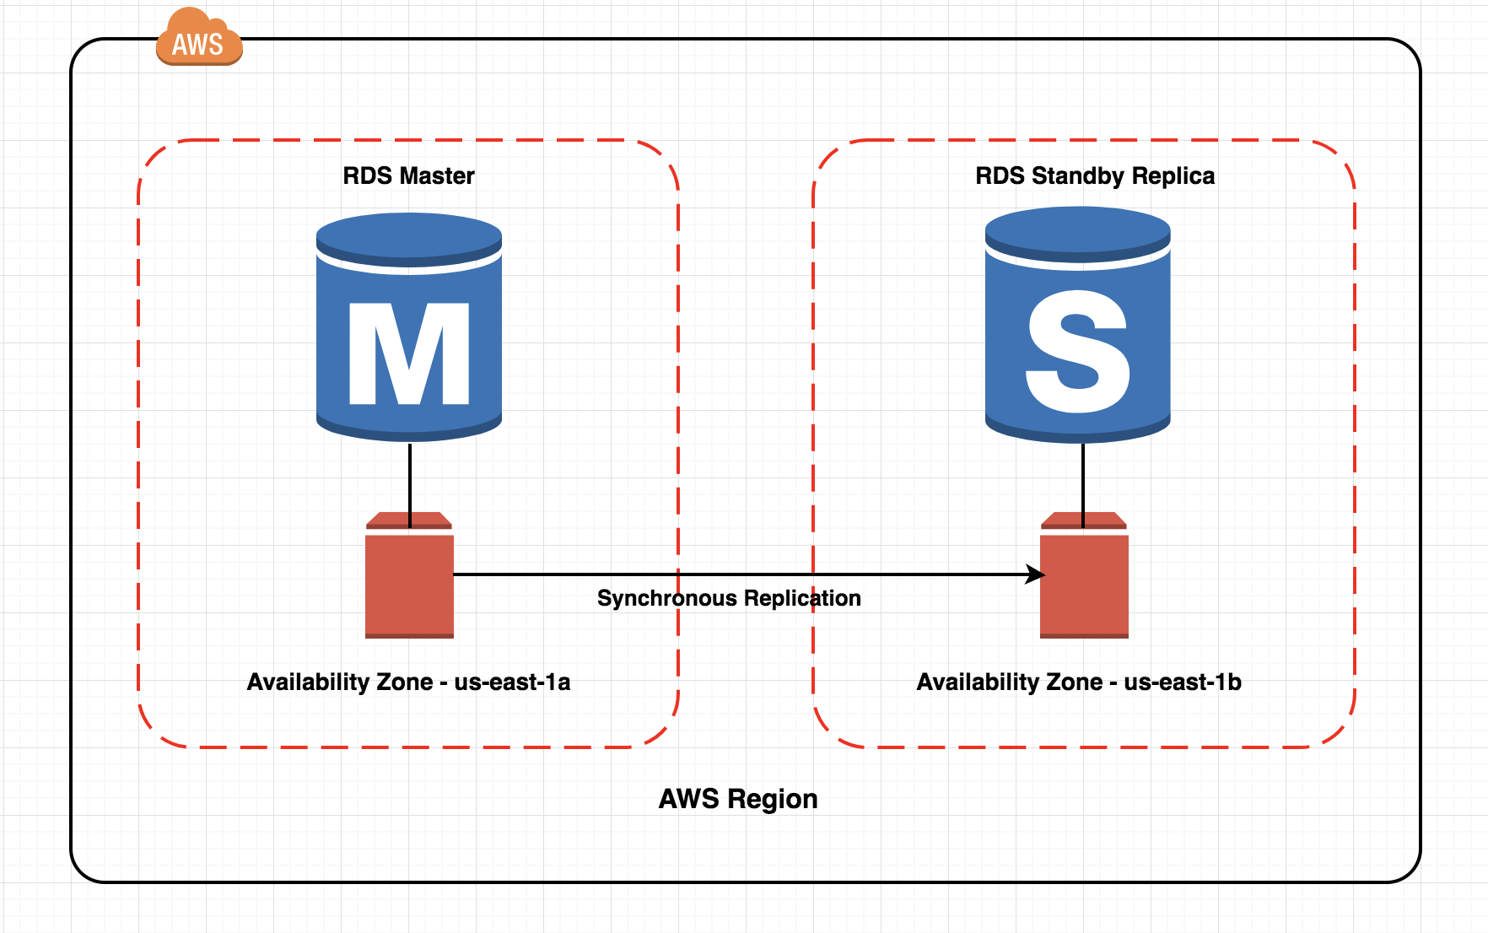
Amazon RDS Multi-AZ deployment

Slide 8
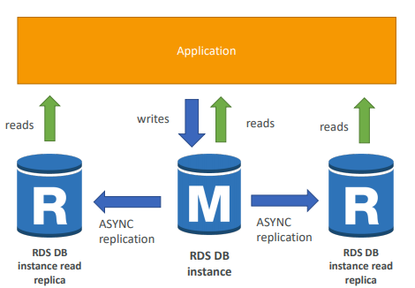
Amazon RDS Read Replicas

Slide 9
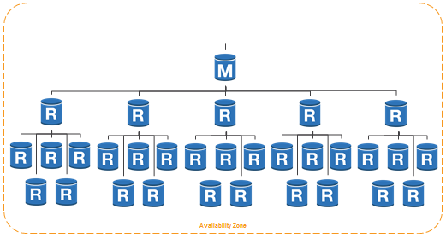
Read Replicas from other Read Replica

Slide 10
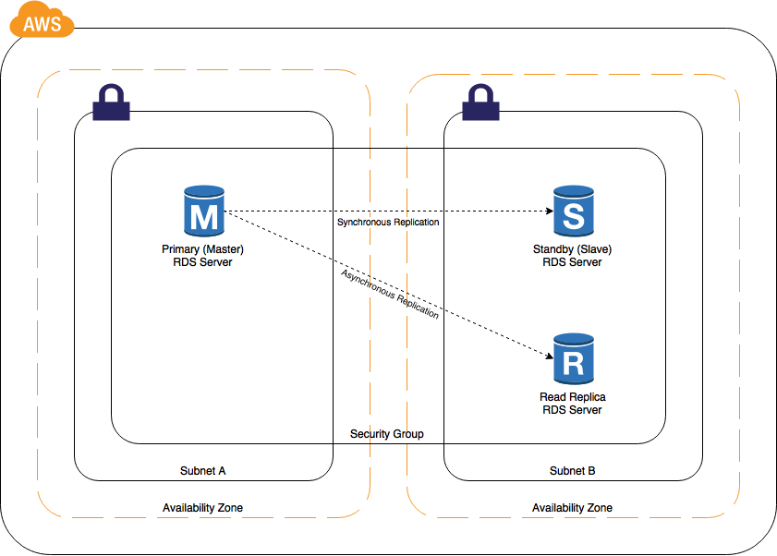
Read Replica and slave

Slide 11
Amazon Aurora
Amazon Aurora (Aurora) is a fully managed relational database engine that's compatible with MySQL and PostgreSQL
Primary DB instance – Supports read and write operations, and performs all of the data modifications to the cluster volume. Each Aurora DB cluster has one primary DB instance.
Aurora Replica – Connects to the same storage volume as the primary DB instance and supports only read operations. Each Aurora DB cluster can have up to 15 Aurora Replicas in addition to the primary DB instance. Maintain high availability by locating Aurora Replicas in separate Availability Zones. Aurora automatically fails over to an Aurora Replica in case the primary DB instance becomes unavailable.

Slide 12
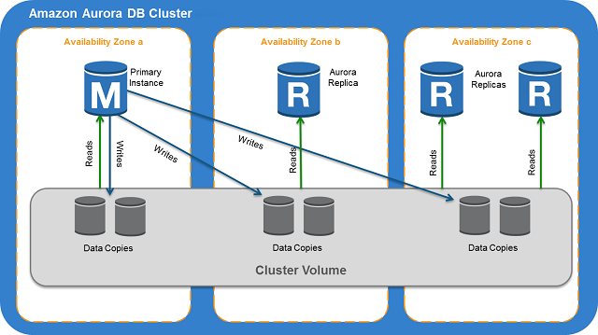
Amazon Aurora

Slide 13
Muchas Gracias

